Slide 1
Roslyn Code Gems K. Scott Allen

Slide 2
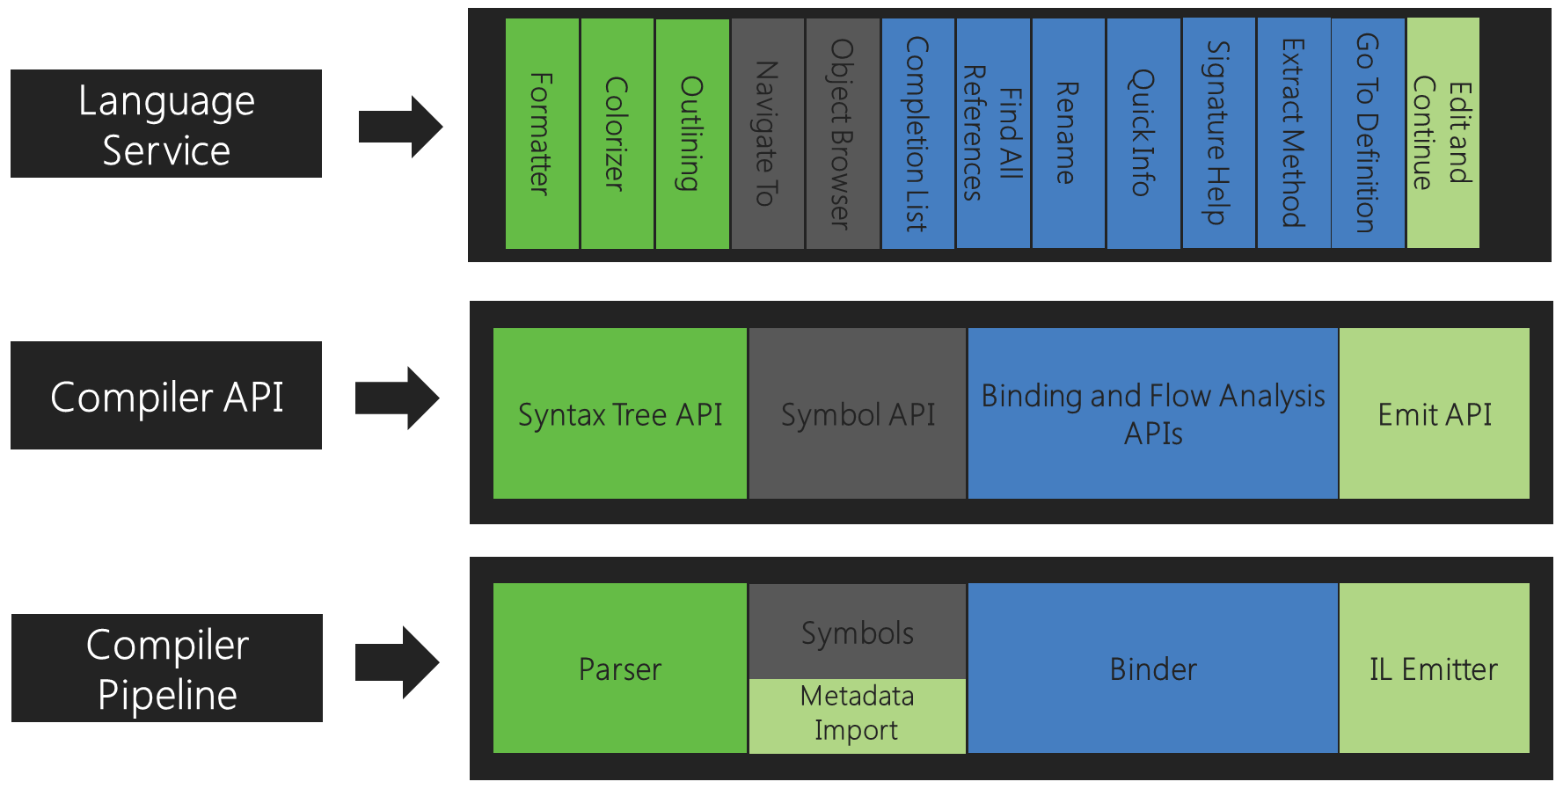

Slide 3
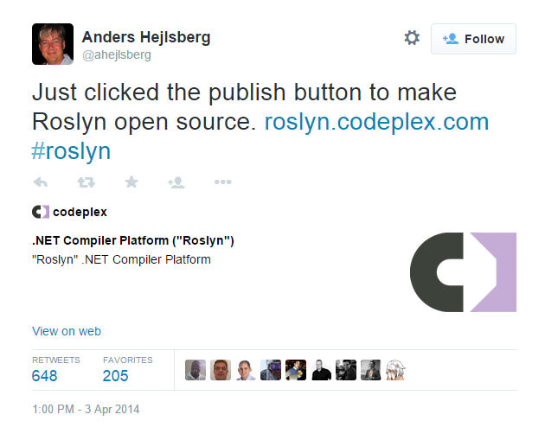

Slide 4
The decision to make Roslyn open source
did not come out of the blue.
In our original architecture discussions in 2009,
we dreamt of open sourcing our language compilers.
-- Kasey Uhlenhuth, Program Manager, Managed Languages Team

Slide 5
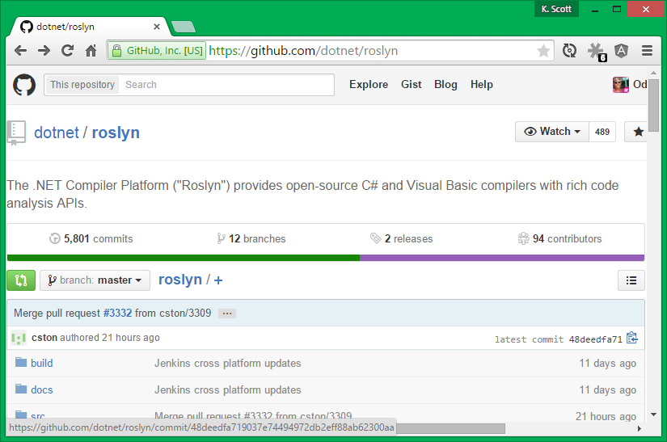

Slide 6
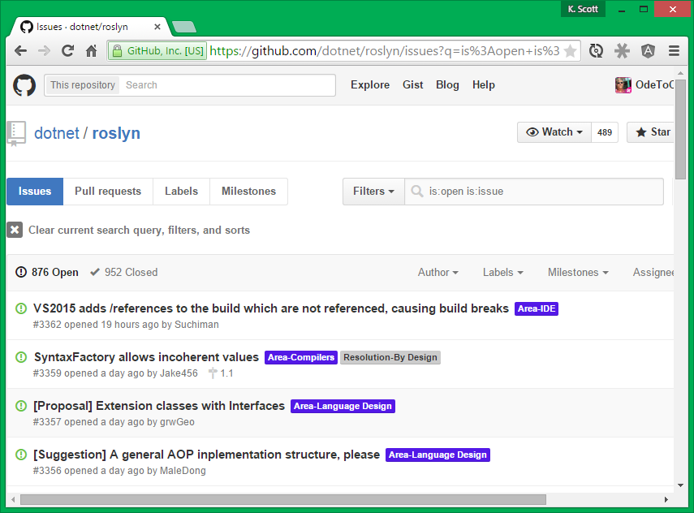

Slide 7
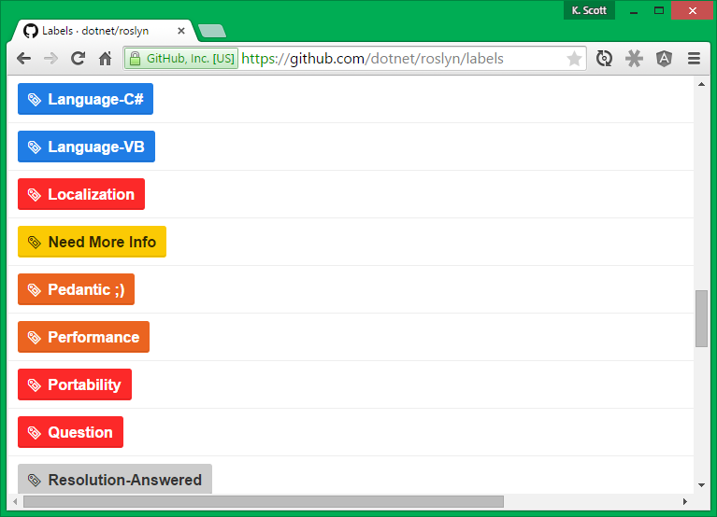

Slide 8
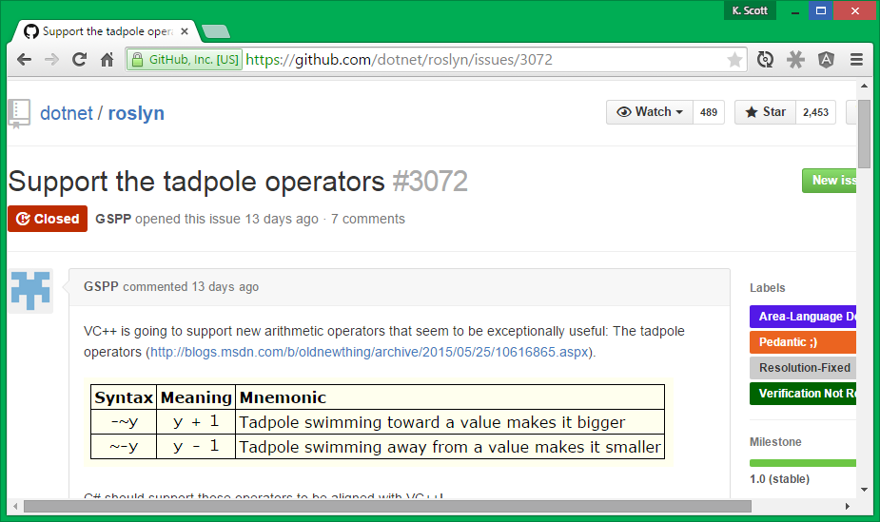

Slide 9

Stats
> 130 Projects
> 3.5 million lines of code

Slide 10
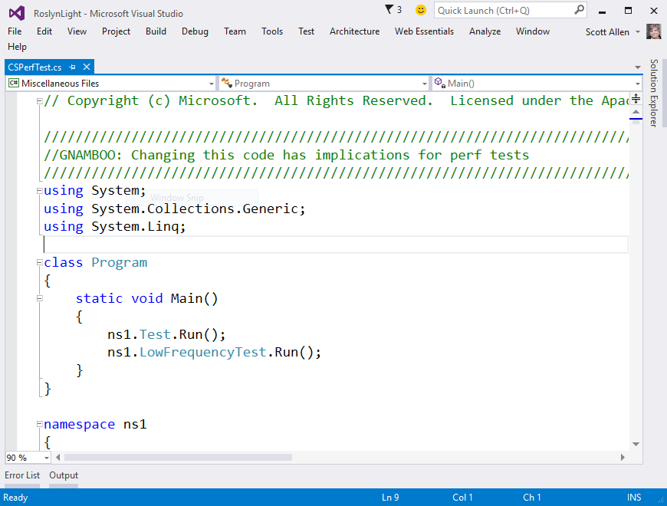
Performance

Slide 11
?
What is Roslyn obsessed about?
CPU usage
Memory allocations
Disk IO
Moving all your code to Azure

Slide 12
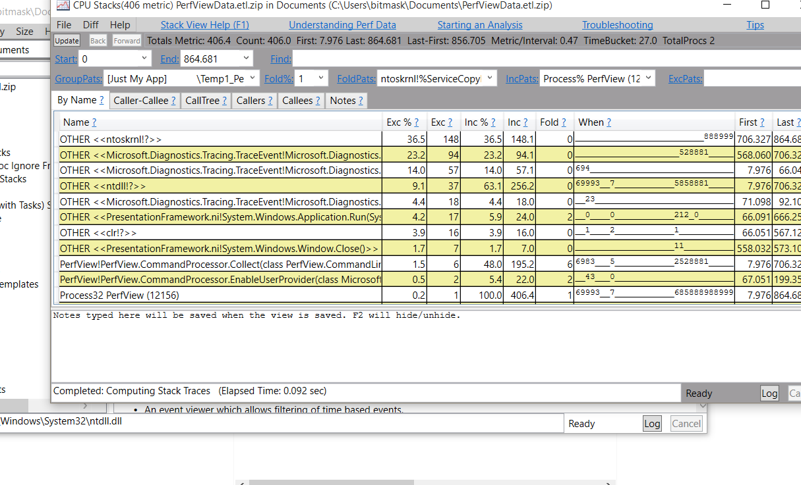
PerfView

Slide 13
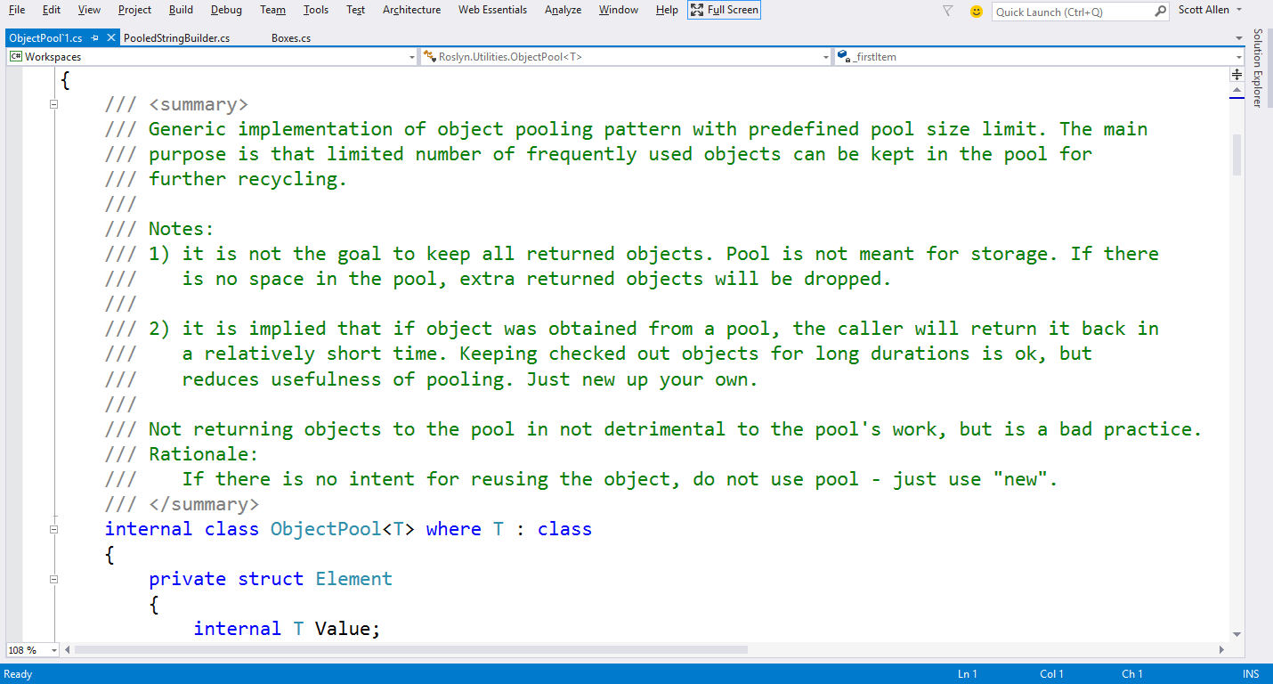
Pooling

Slide 14
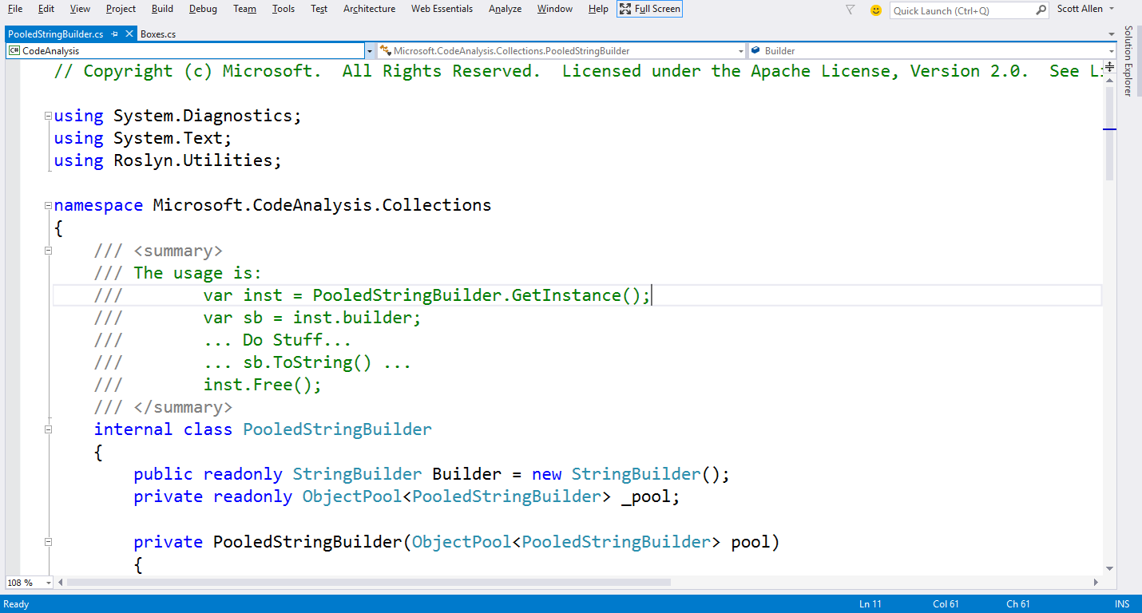
Pooled String Builder

Slide 15
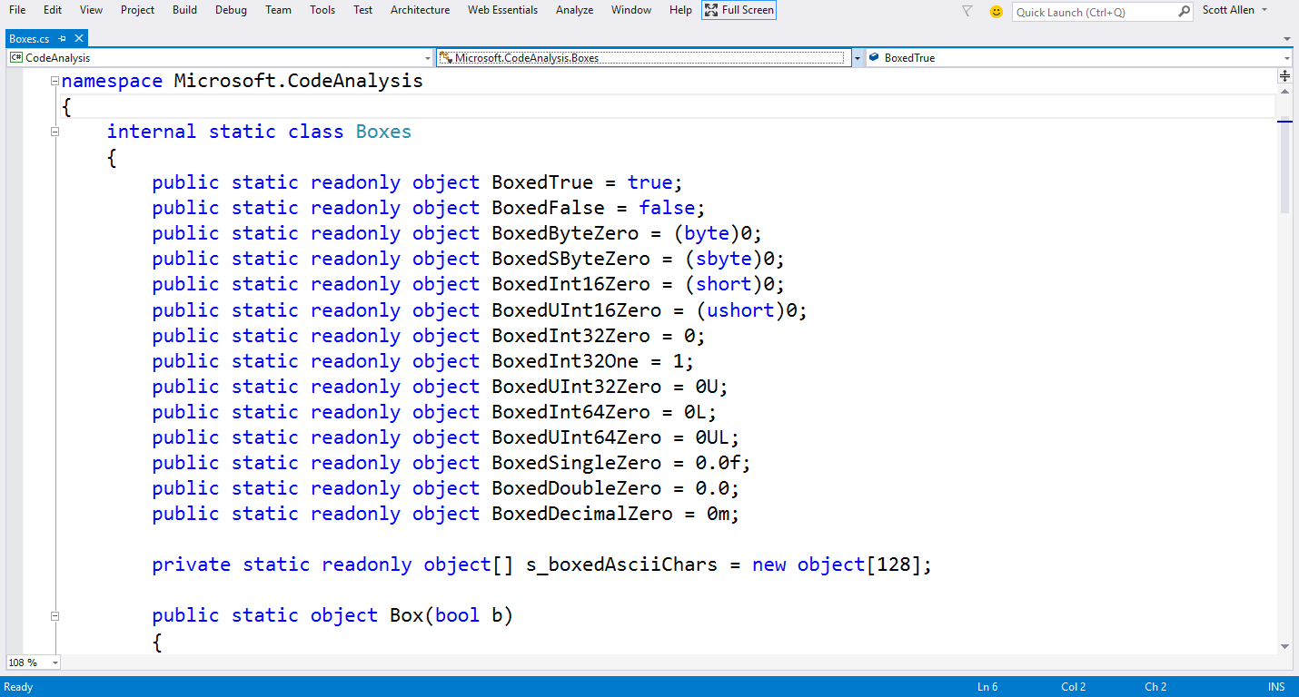
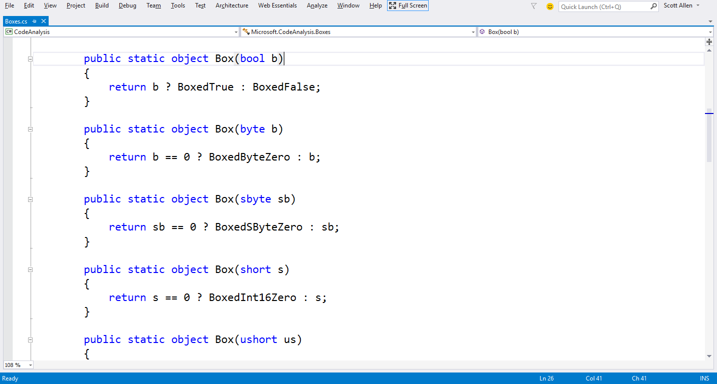
Boxing

Slide 16
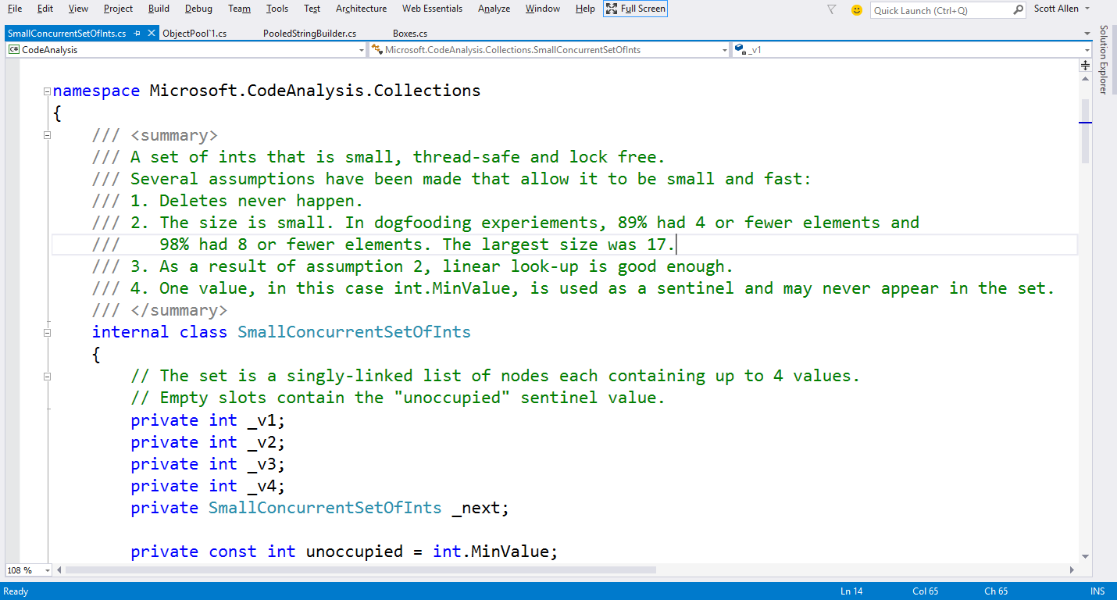
Small Collections (Int)

Slide 17
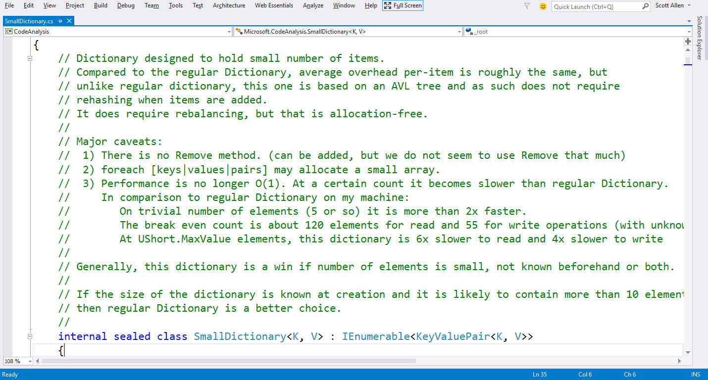
Small Dictionary

Slide 18
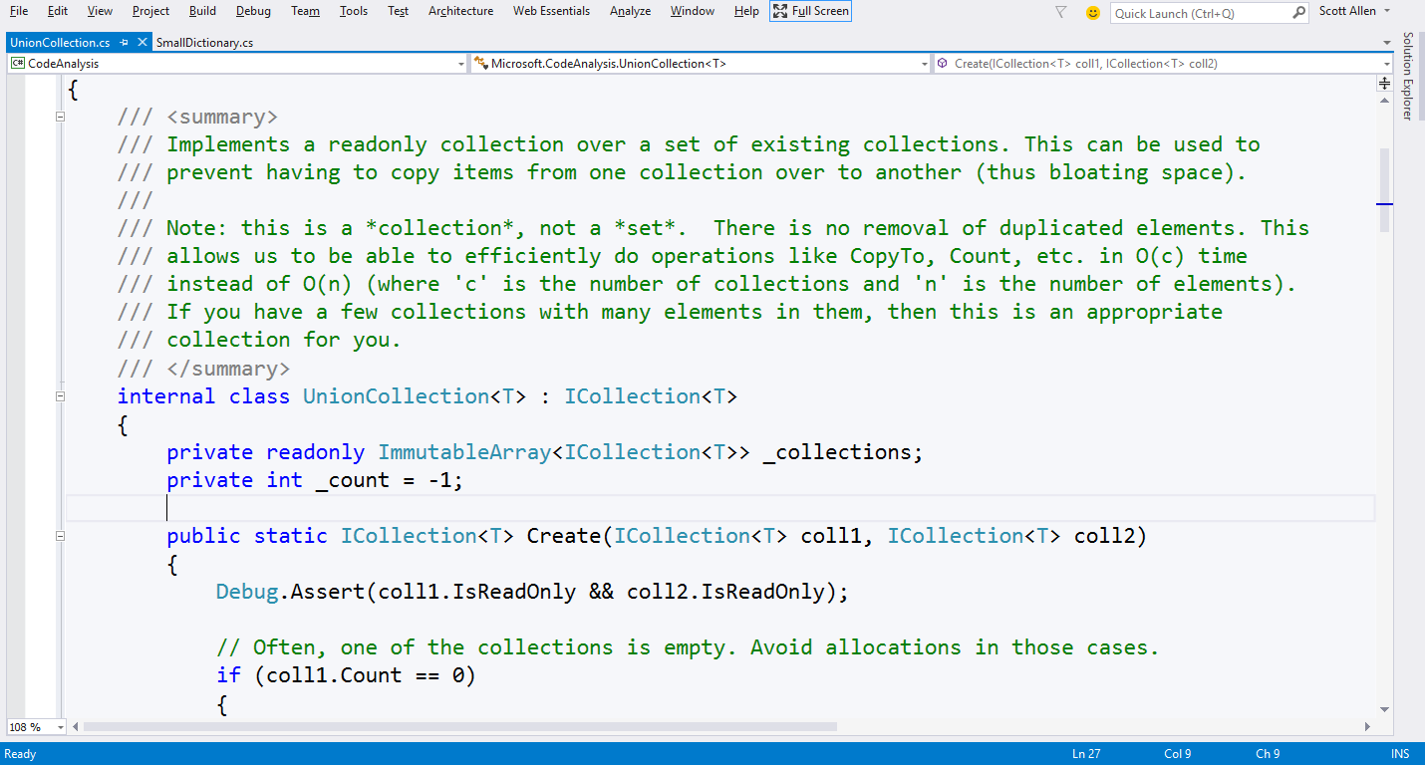
UnionCollection

Slide 19
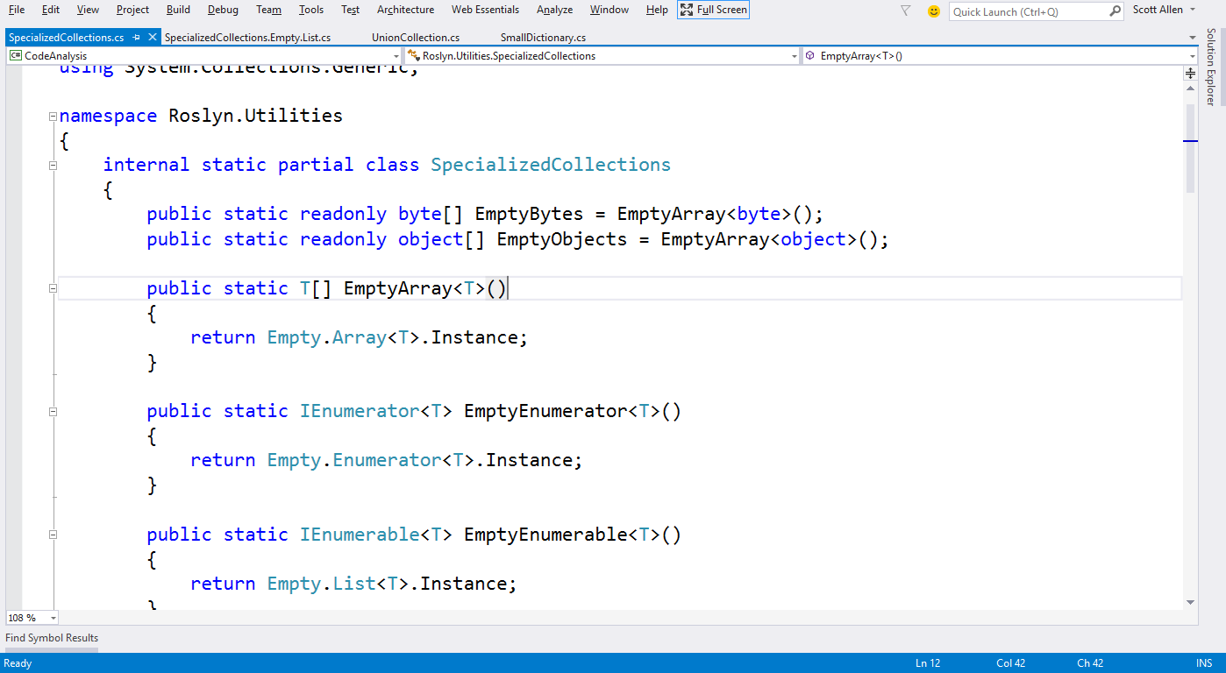
Empty Collections

Slide 20
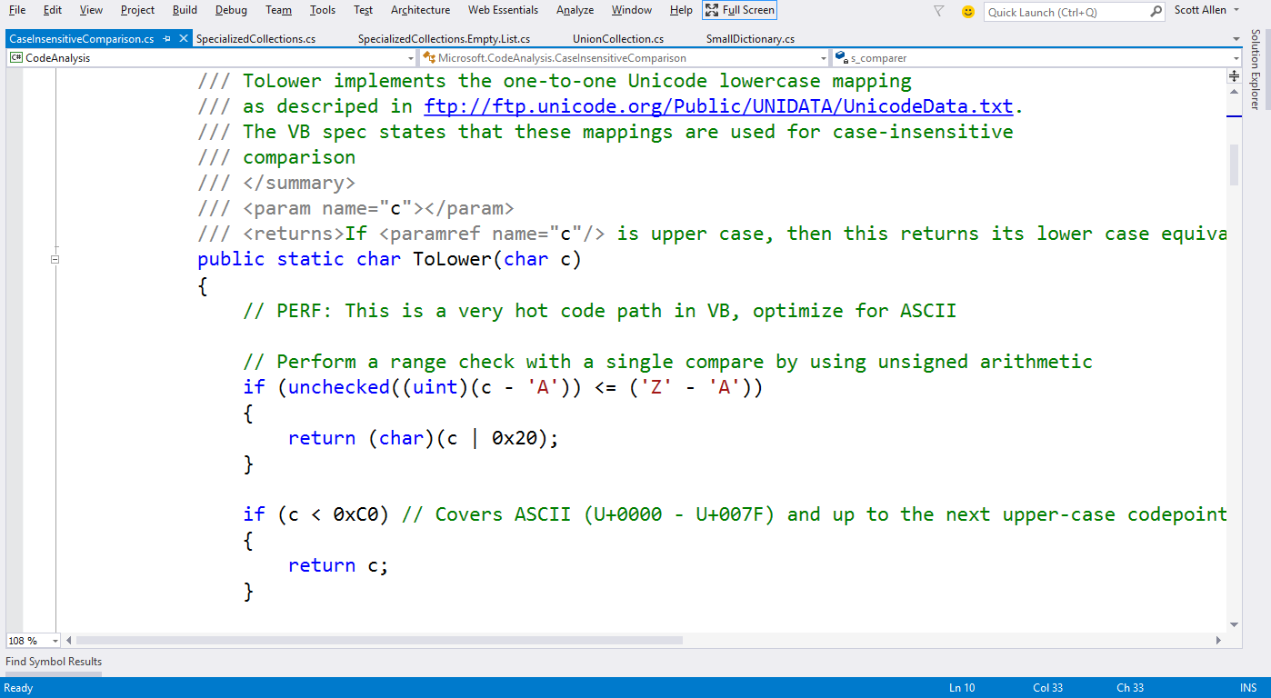
CaseInsensitiveComparison :: ToLower

Slide 21
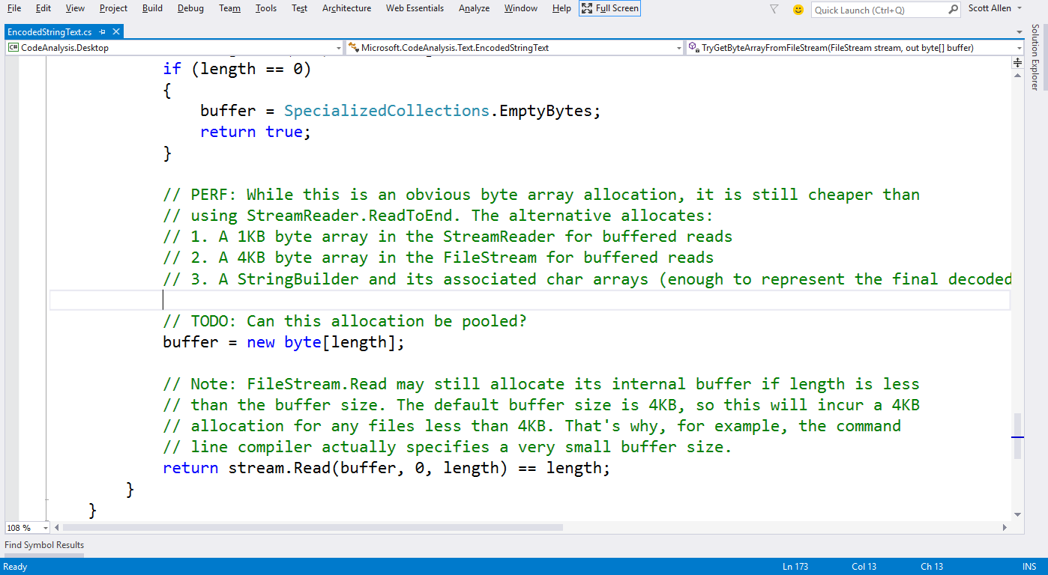
EncodedStringText :: TryGetByteArrayFromFileStream

Slide 22
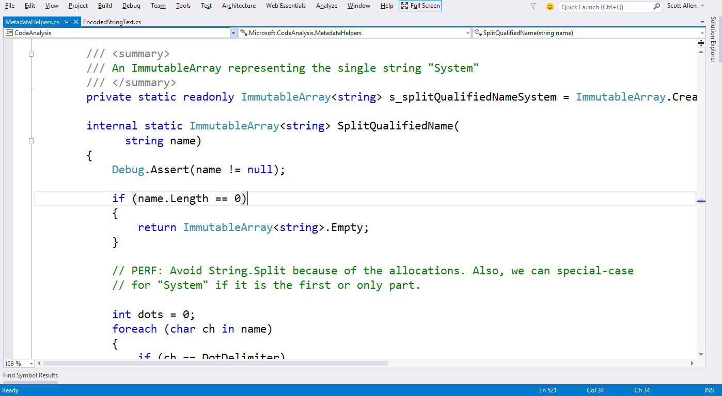
MetadataHelper :: SplitNamespaces

Slide 23
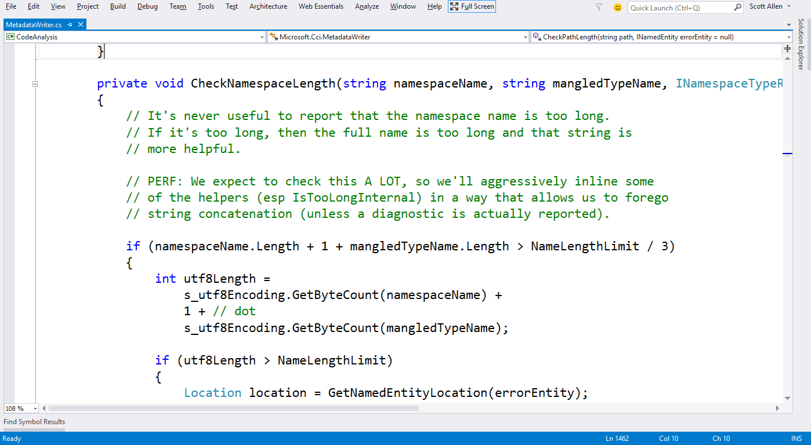
MetaDataWriter : CheckNamespaceLength

Slide 24
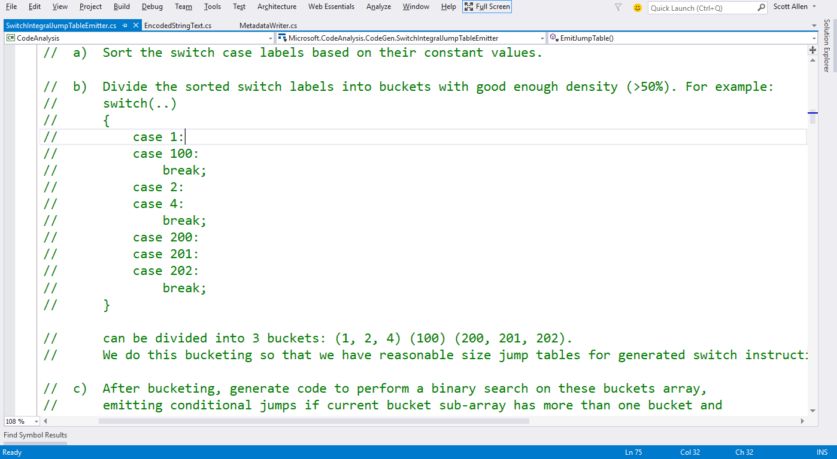
SwitchIntegralJumpTableEmitter

Slide 25
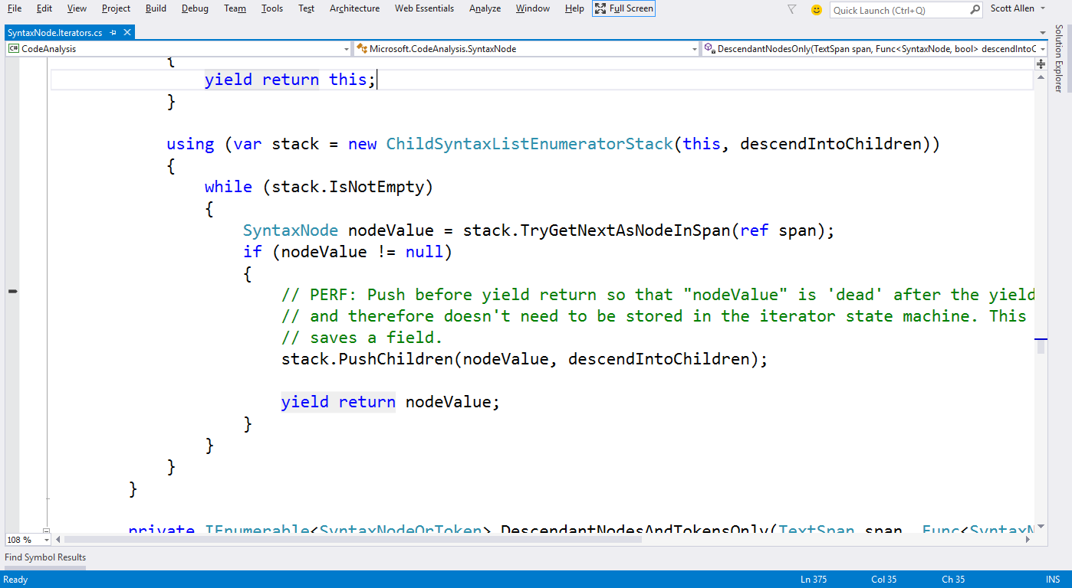
SyntaxNode.Iterator

Slide 26
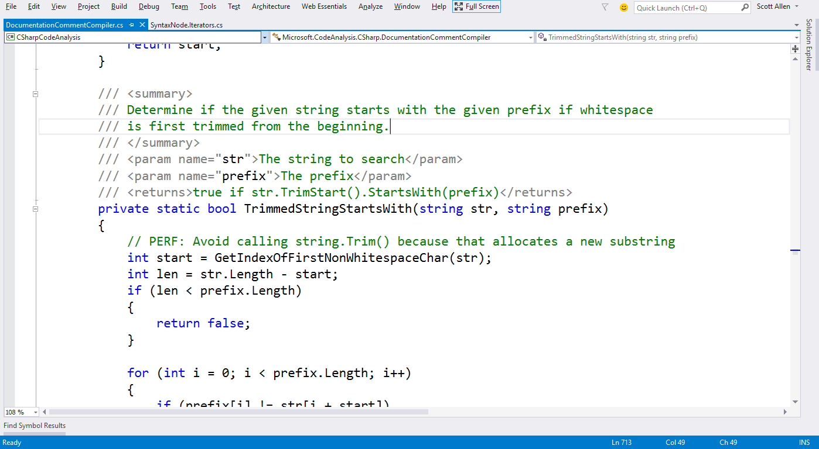
DocumentCommentCompiler

Slide 27
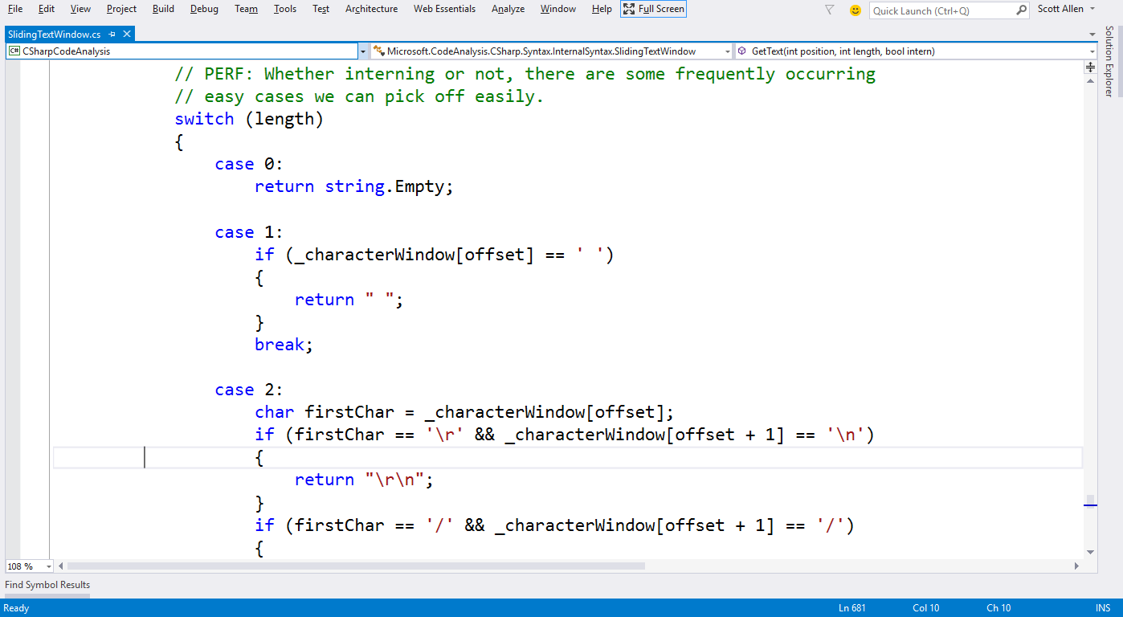
SlidingTextWindow :: GetText

Slide 28
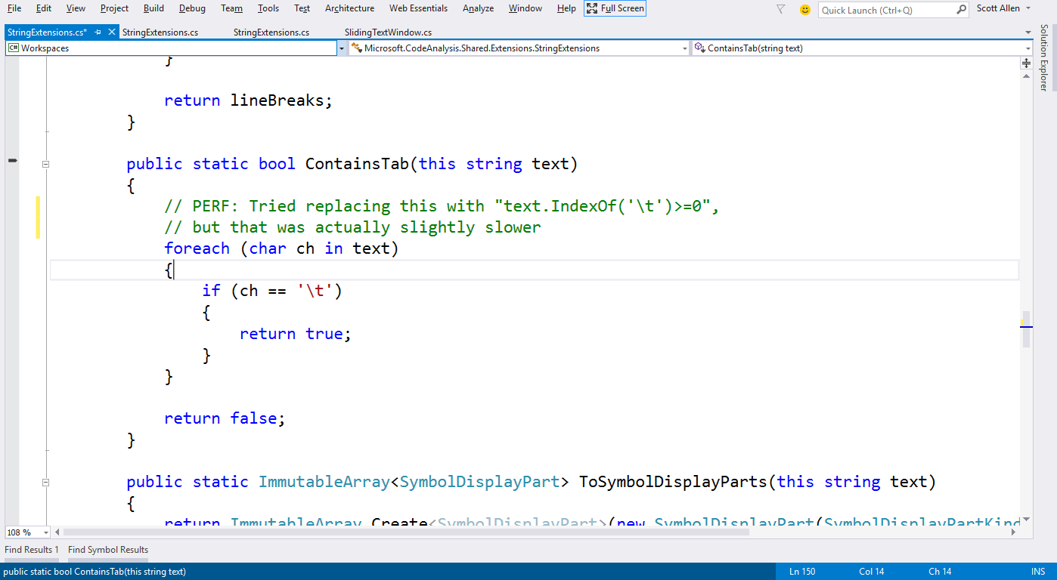
StringExtensions :: ContainsTab

Slide 29
Comments

Slide 30
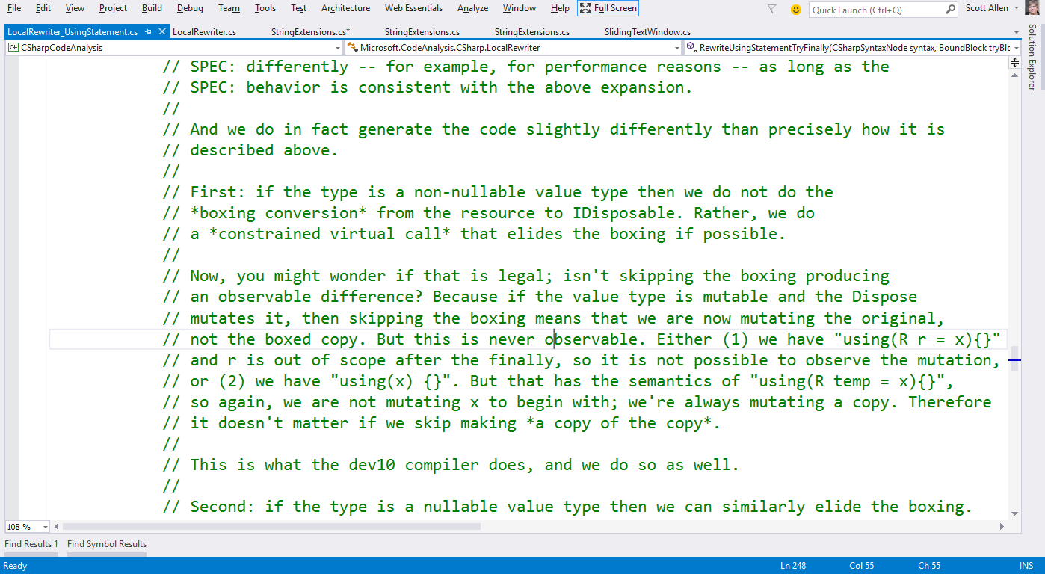
LocalRewriter_UsingStatement

Slide 31
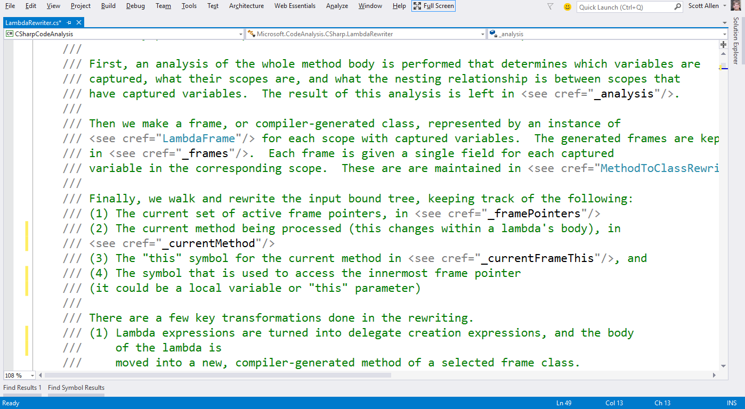
Lambda Rewriter

Slide 32
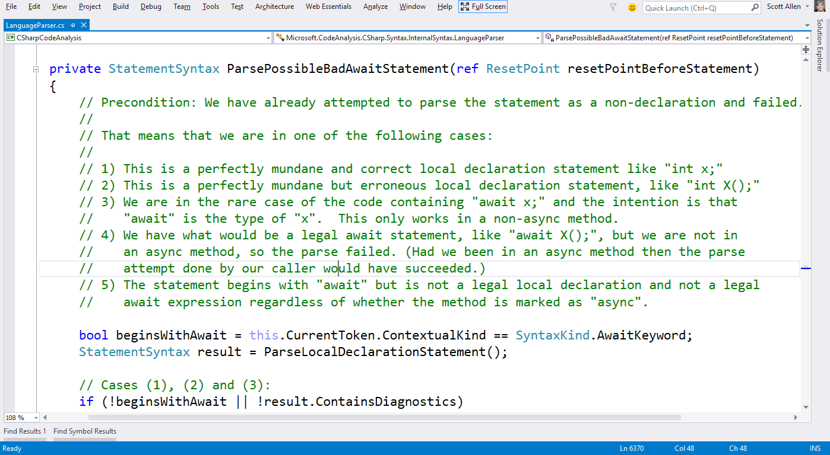
LanguageParser

Slide 33
Useful

Slide 34
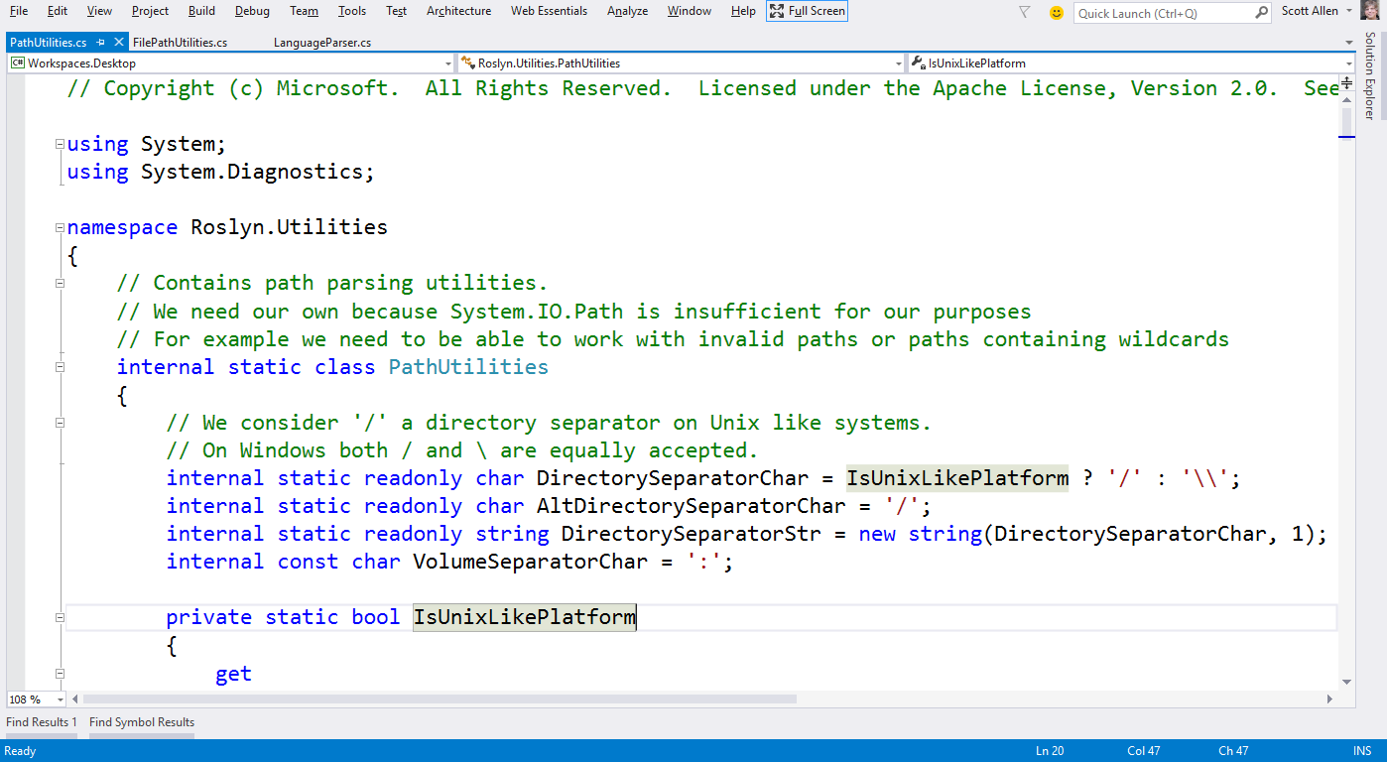
Path Utilities

Slide 35
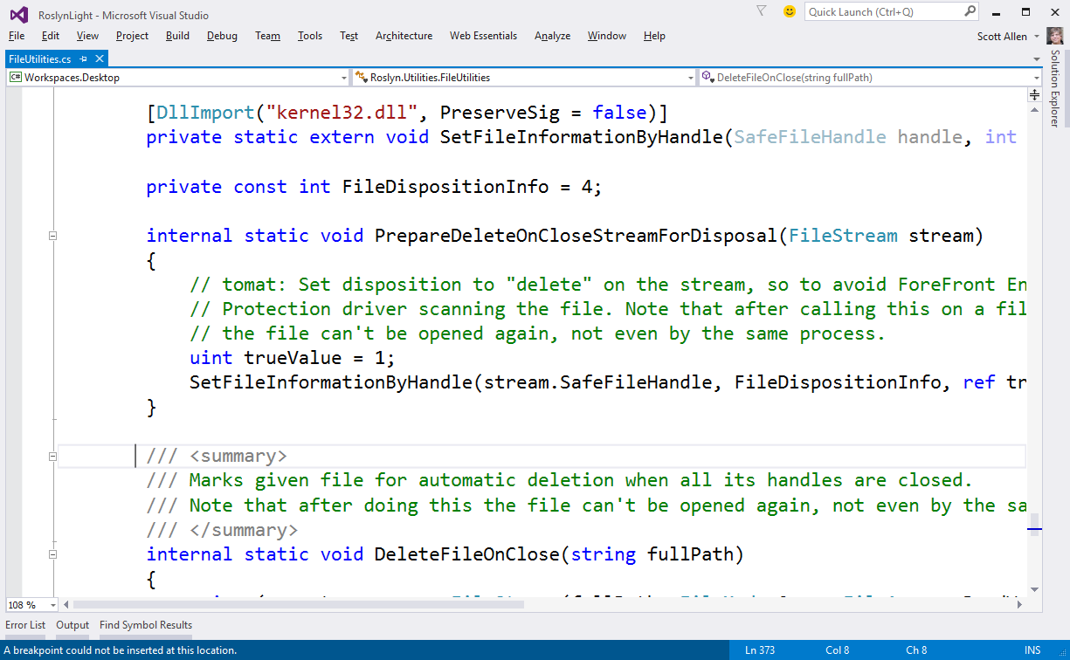
File Utilities

Slide 36
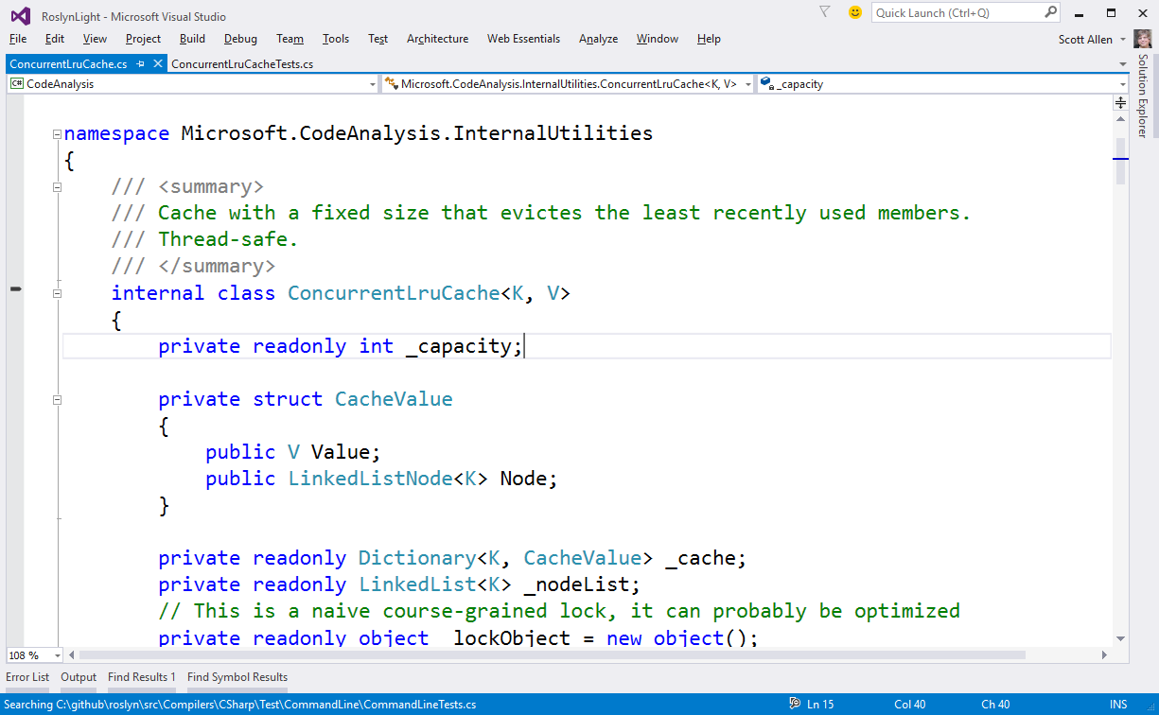
ConcurrentLruCache

Slide 37
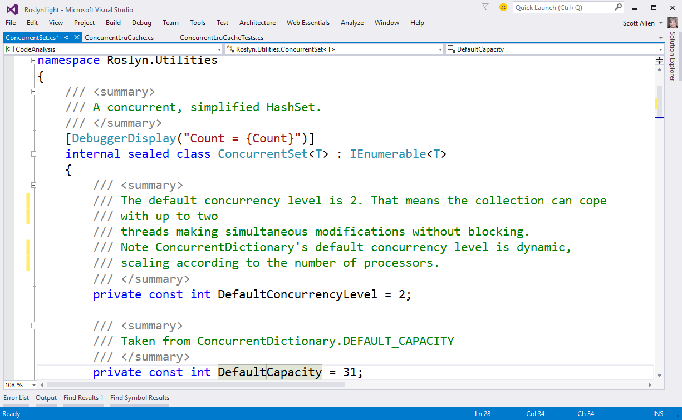
ConcurrentSet

Slide 38
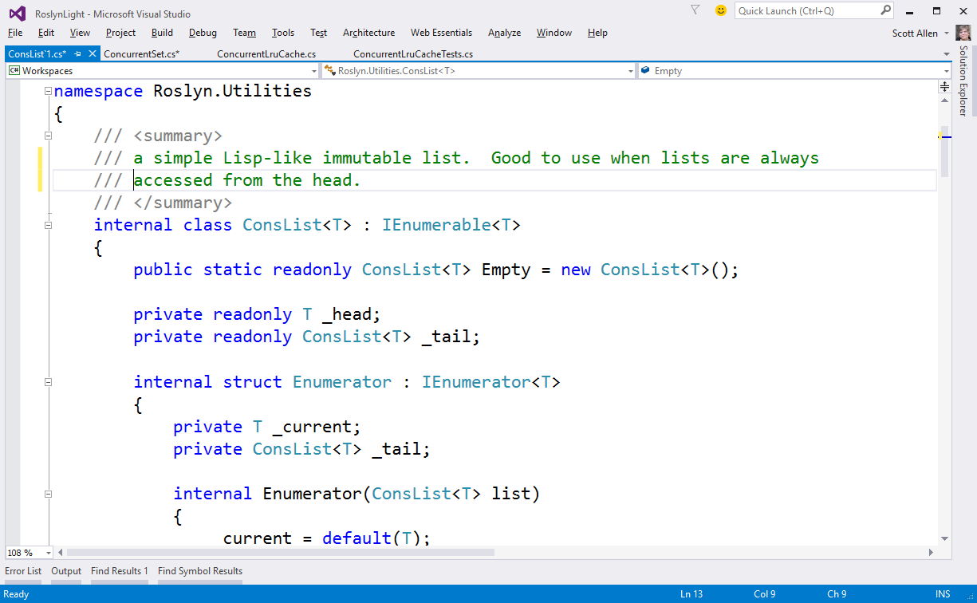
ConsList

Slide 39
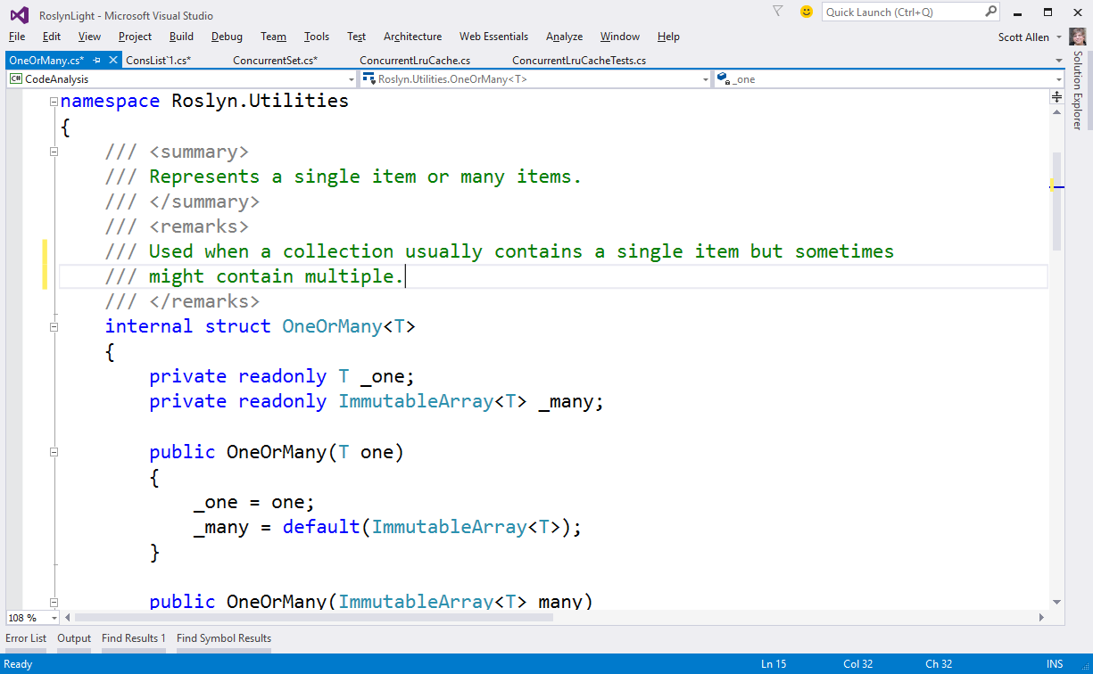
OneOrMany

Slide 40
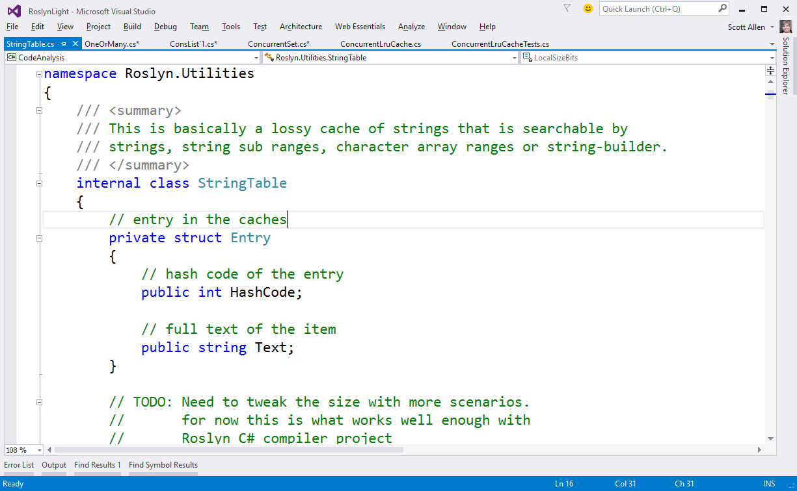
String Table

Slide 41
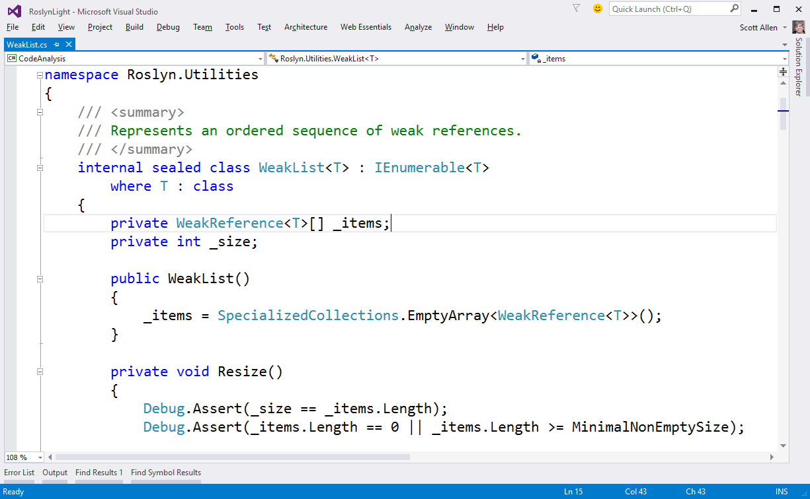
WeakList

Slide 42
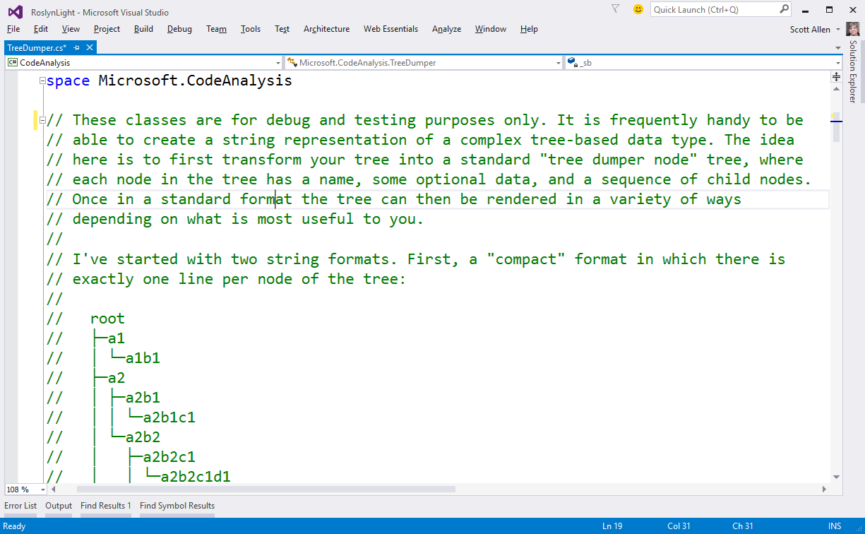
TreeDumper

Slide 43
Interesting?

Slide 44
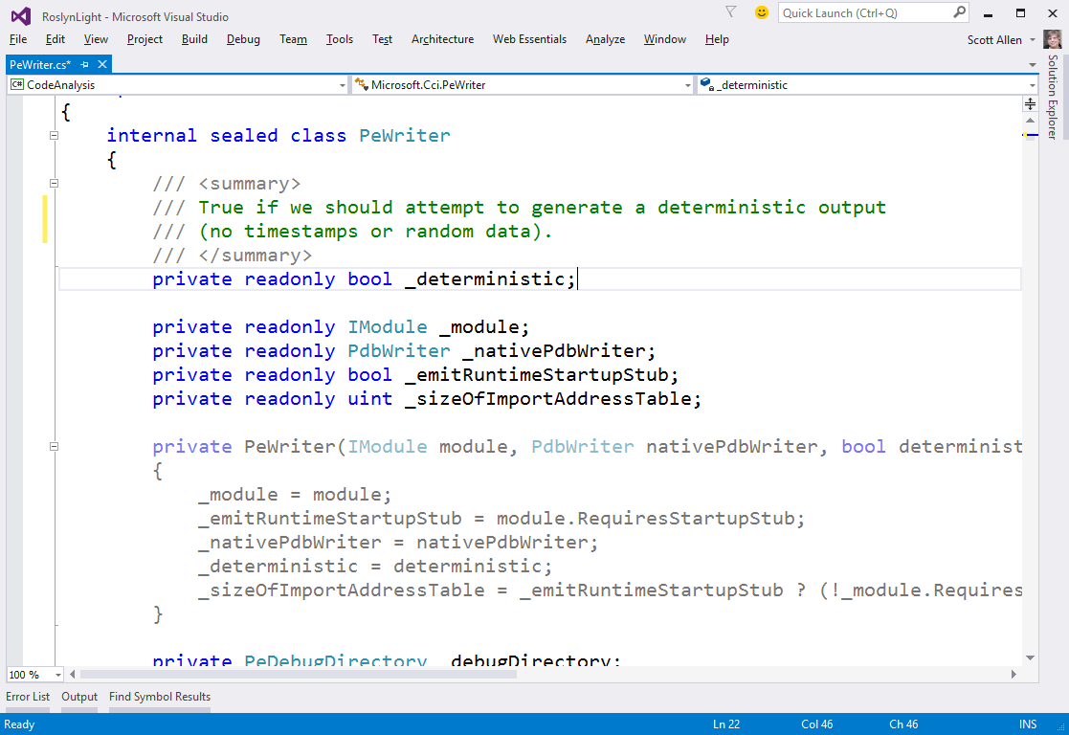
PeWriter

Slide 45
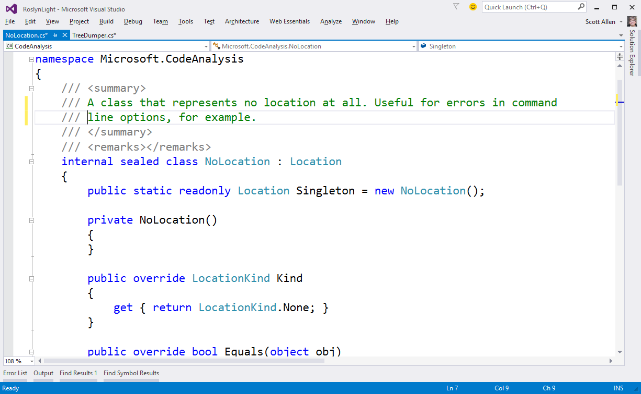
NoLocation

Slide 46
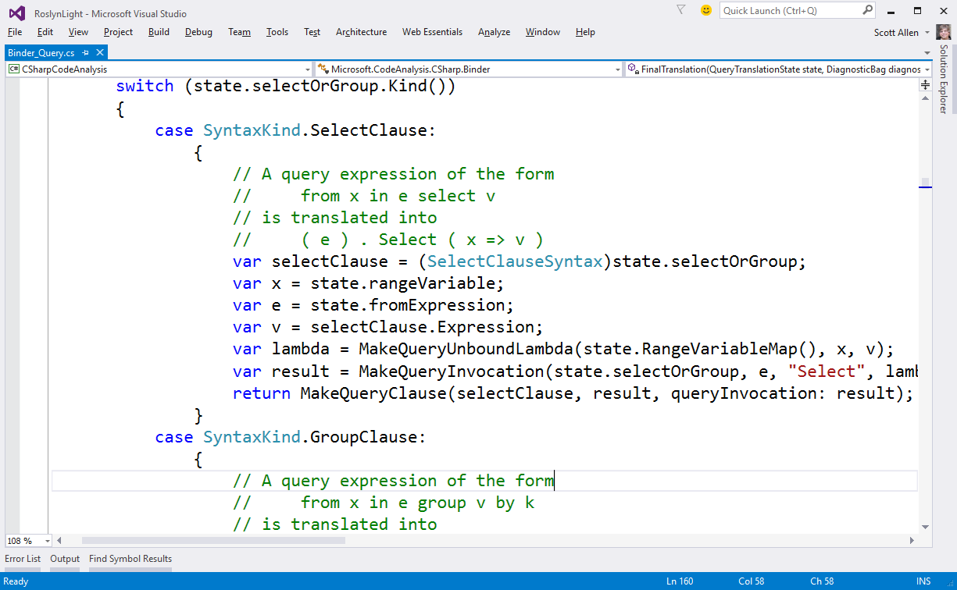
BinderQuery

Slide 47
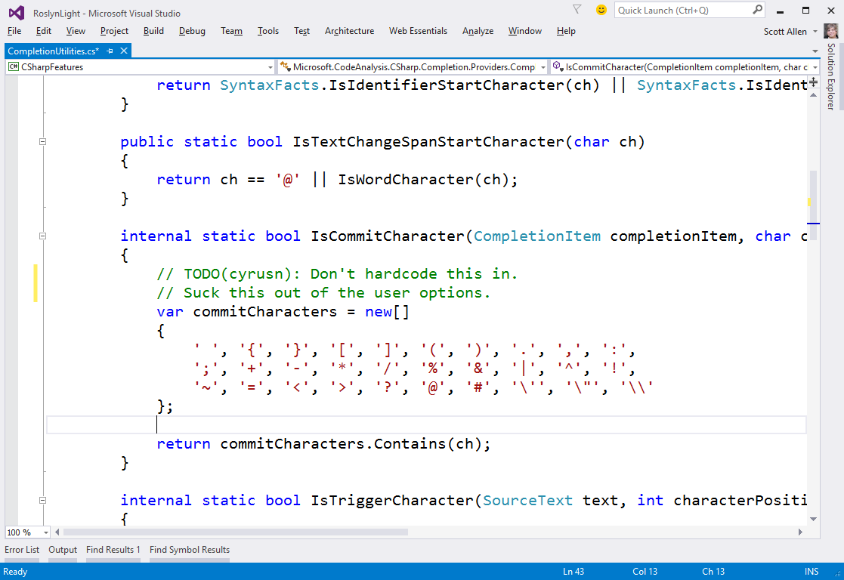
CompletionUtilities

Slide 48
Generics

Slide 49
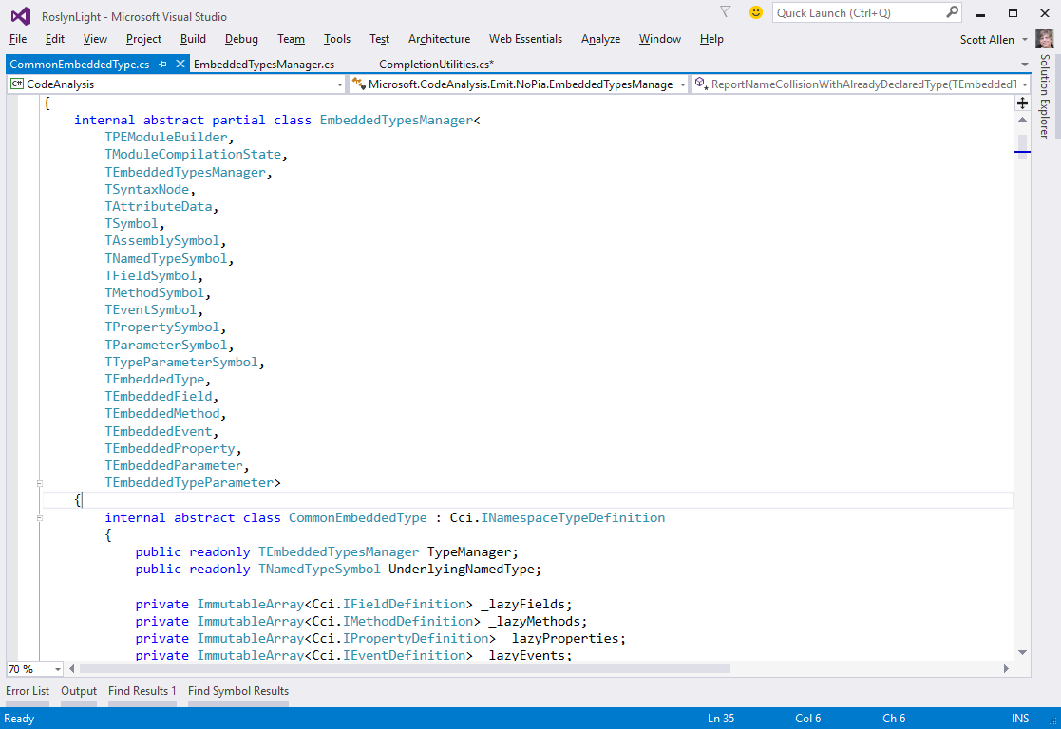
EmbeddedTypesManager

Slide 50
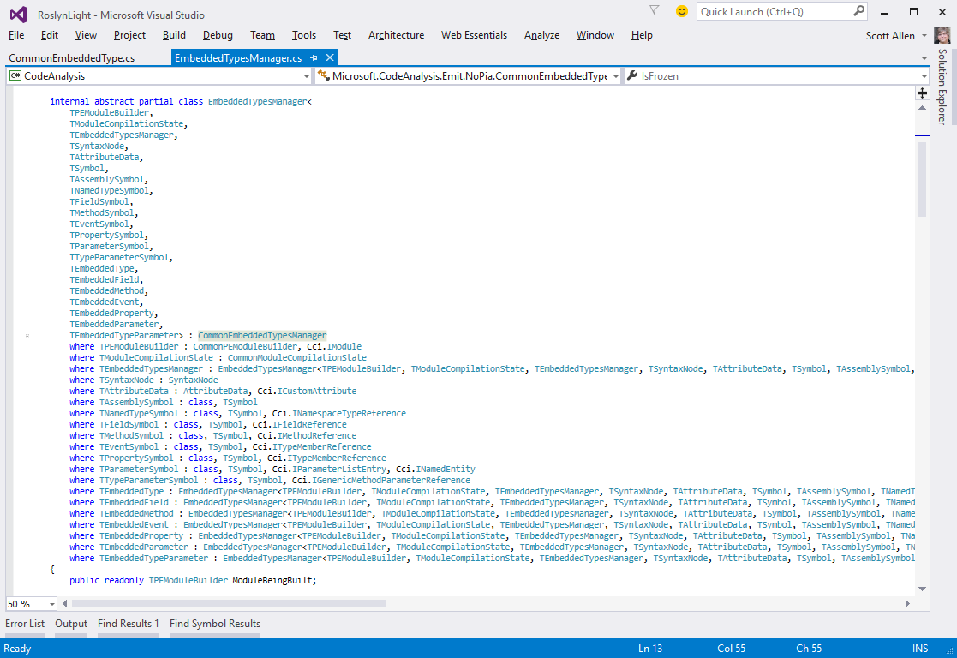
EmbeddedTypesManager

Slide 51
Patterns

Slide 52
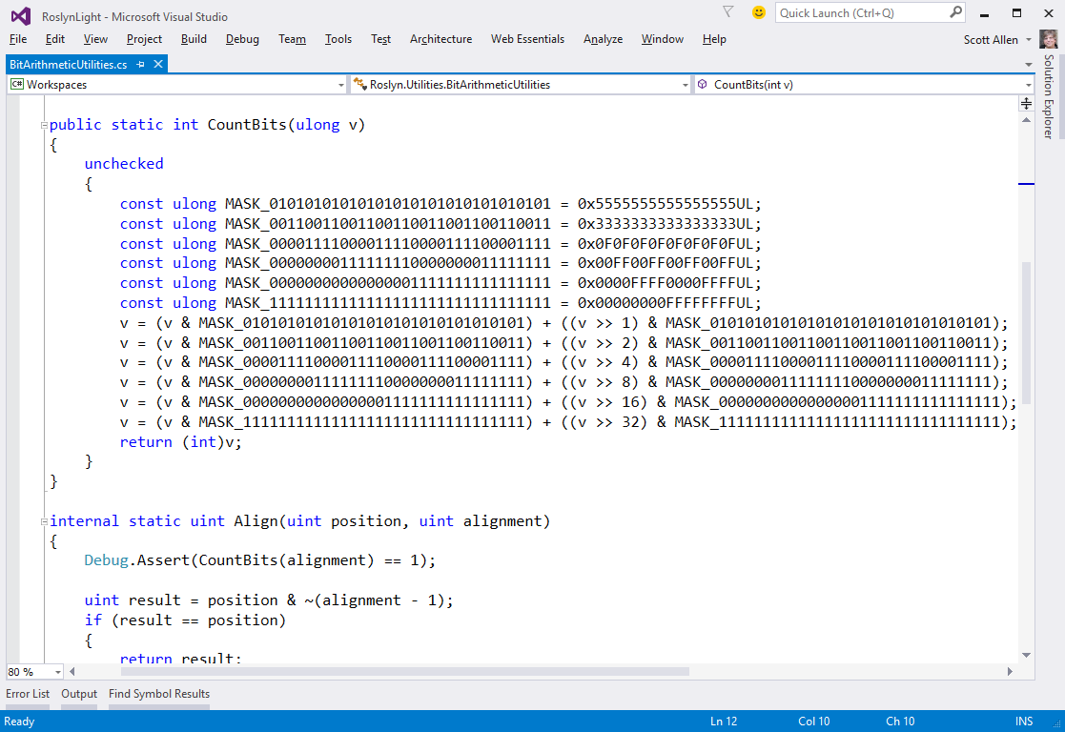
BitCounter

Slide 53
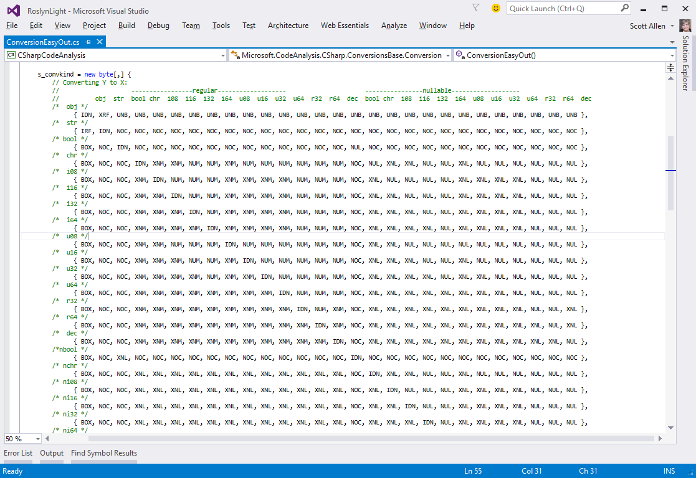
ConversionEasyOut

Slide 54
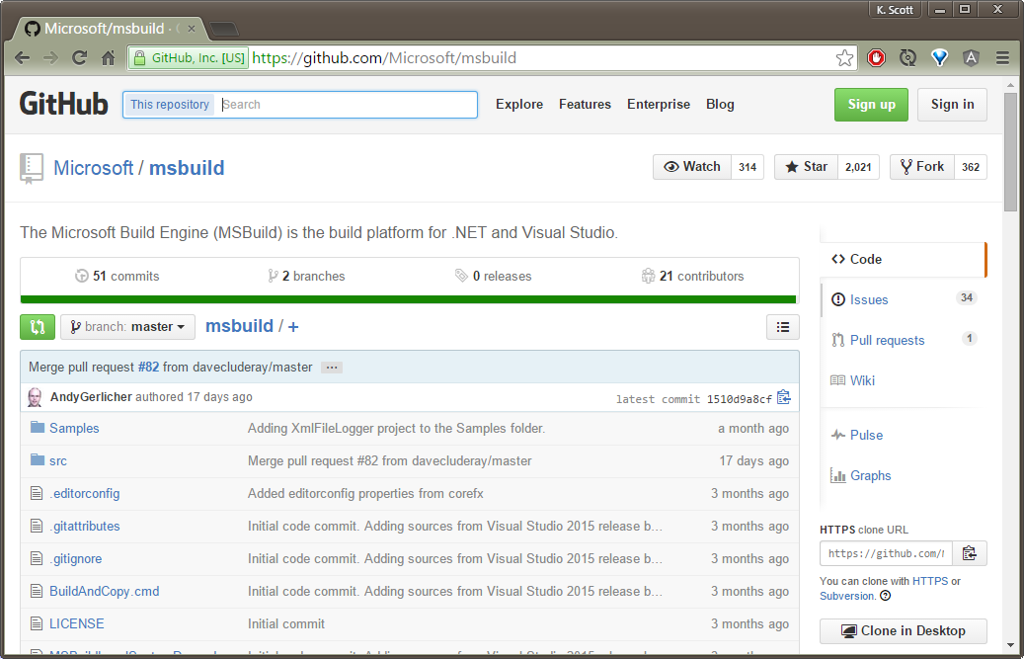
MSBuild

Slide 55
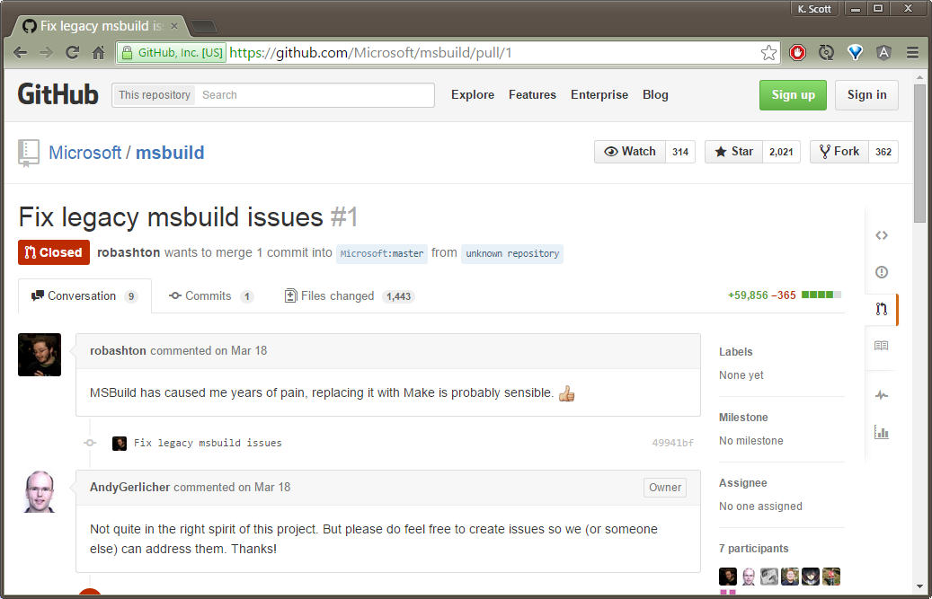
First Pull Request

Slide 56
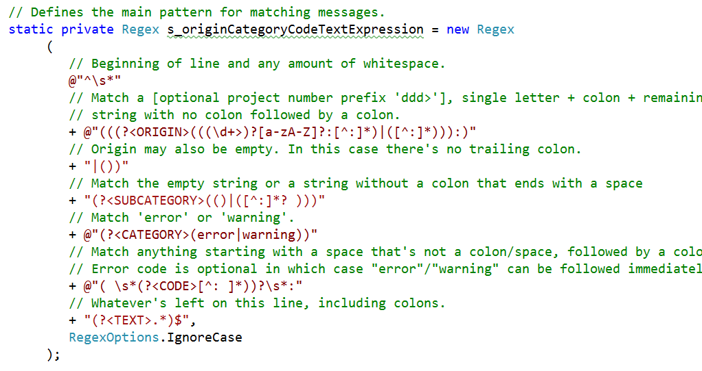
CanonicalError

Slide 57
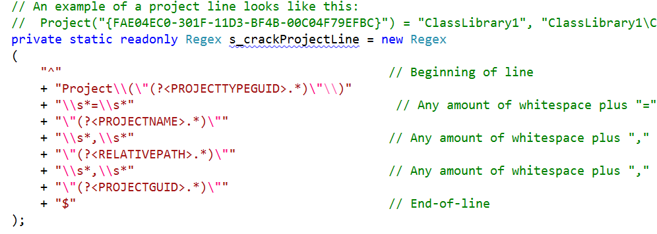
SolutionFile

Slide 58
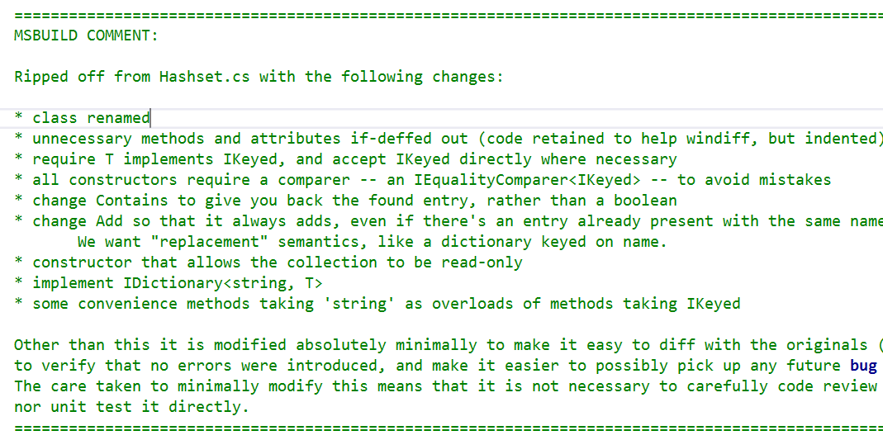
HashSet

Slide 59

CopyOnReadEnumerable

Slide 60

LookasideStringInterner

Slide 61

OpportunisticIntern

Slide 62

ReusableStringBuilder

Slide 63

StringBuilderCache

Slide 64

GetFrameworkPath

Slide 65

ErrorUtilities

Slide 66

InternalErrorException

Slide 67

EscapingUtilities

Slide 68
Tests

Slide 69

Compiling Code

Slide 70

Emit Tests

Slide 71

Testing PDB Output

Slide 72

Breaking Changes

Slide 73

Breaking Changes

Slide 74

Options Tests

Slide 75

Compile and Verify

Slide 76

ColorColor Tests

Slide 77

Fuzz Testing

Slide 78

Switch Tests

Slide 79

Test Everything

Slide 80

TODOs

